Slide 1
BMC Cyber and Cloud Summer Courses Deep Learning for Computer Vision Course Overview
Samuel Adebayo
sadebayo@belfastmet.ac.uk

Slide 2
Course Objectives
Gain a foundational understanding of deep learning concepts.
Learn to implement various Computer Vision models using TensorFlow/PyTorch.
Explore advanced topics like Object Detection, Segmentation, RNNs, and GANs.
Engage in hands-on projects to reinforce learning.

Slide 3
Course Structure
4 Days in Total
Each day includes both lectures and hands-on sessions.
Day 4 will focus on revision.

Slide 4
Day 1 Overview
Introduction to Python
Introduction to Deep Learning
Basics of Computer Vision
Introduction to Convolutional Neural Networks (CNNs)
Hands-On: Basic Image Classification using CNNs

Slide 5
Day 2: Overview
Advanced CNN Architectures
Object Detection Techniques
Transfer Learning and Fine-Tuning
Hands-On: Object Detection and Transfer Learning

Slide 6
Day 3: Overview
Image Segmentation Techniques
Introduction to RNNs, LSTMs, and GRUs
Introduction to GANs
Hands-On: Segmentation, RNNs, and GANs

Slide 7
Day 4: Overview
Revision and Q&A
Project Presentations and Feedback

Slide 8
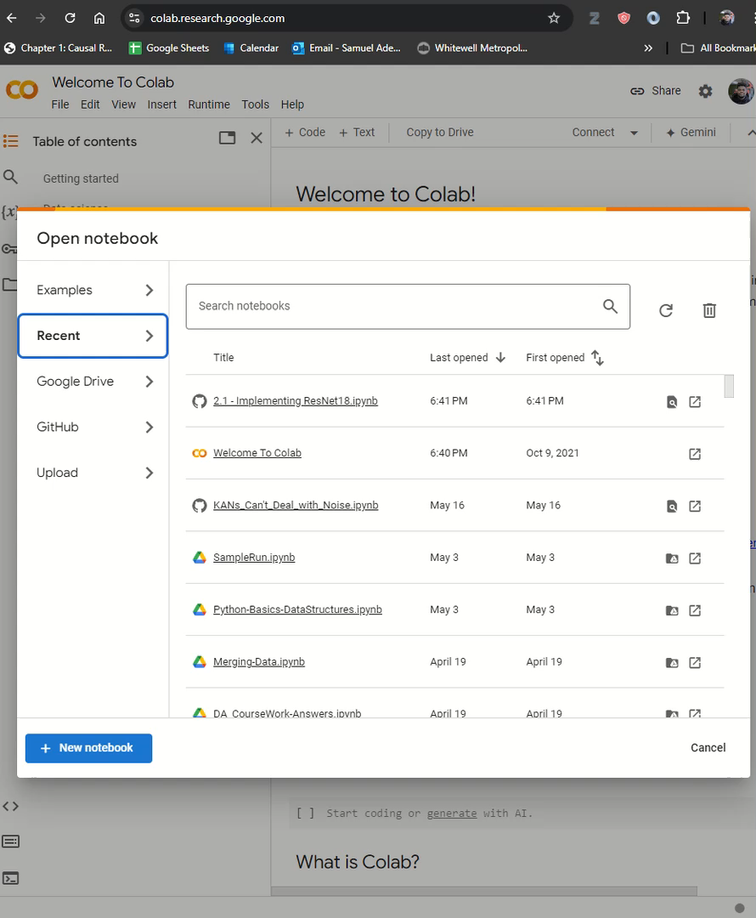
Tools and Resources
Software: Pytorch, OpenCV
Datasets: MNIST, CIFAR-10, COCO, UCF101
Fork this repository https://github.com/exponentialR/DL4CV
Google Colab Demonstration

Slide 9

Thank You
See you soon

